Slide 1

Major city Crime
Justin Pate
IST-652
Final Project
An analysis of crime breakdown in major cities.
Datasource:
Government Crime open data source
Major city selection for 2018
NOVEMBER 28, 2017

Slide 2
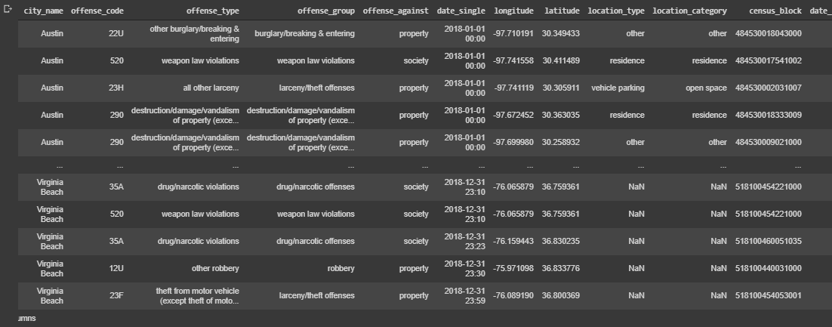
Datasource
The open crime database came from https://osf.io/zyaqn/
This is a publicly posted open database that includes crime statistics. Wiki does a good job at describing the dataset in the following Link https://osf.io/zyaqn/wiki/home/
Sample of dataset is below.
Pre-Processing?
The datasource is relatively clean with a few fields that are someone duplicates that you would not want to consider in your analysis. Offense_code is directly related to offense type. For charting, it is necessary to sample as the datasource is extremely large. The data source by default is in a *.gz file so will need to be opened using compression = “gzip”.
The visualization above if from an aerostructures manufacturing company reflecting quality/defect data on actual products

Slide 3

Analysis Goals
Using python functions in google Collaboratory the following questions will be answered.
Can the type of crime and density be identified by city so that law enforcement can alter a plan for prevention and detection?
Can the latitude and longitude values be used as a tool for home buying and law enforcement concentration as well?
What questions will be answered from this analysis?

Slide 4
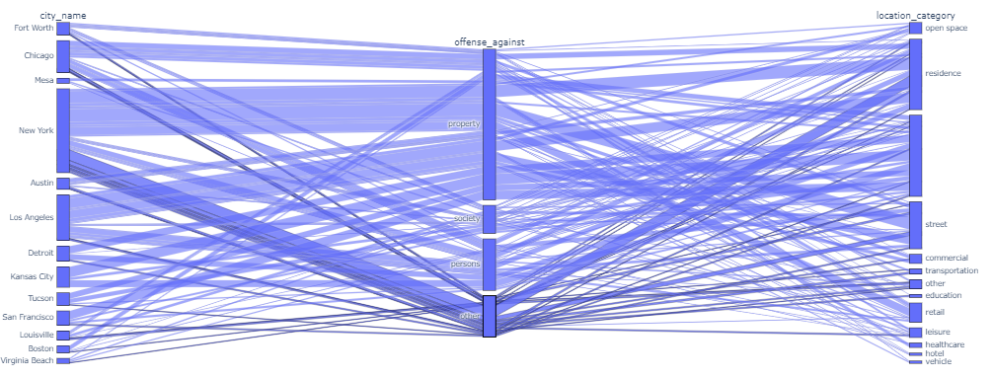
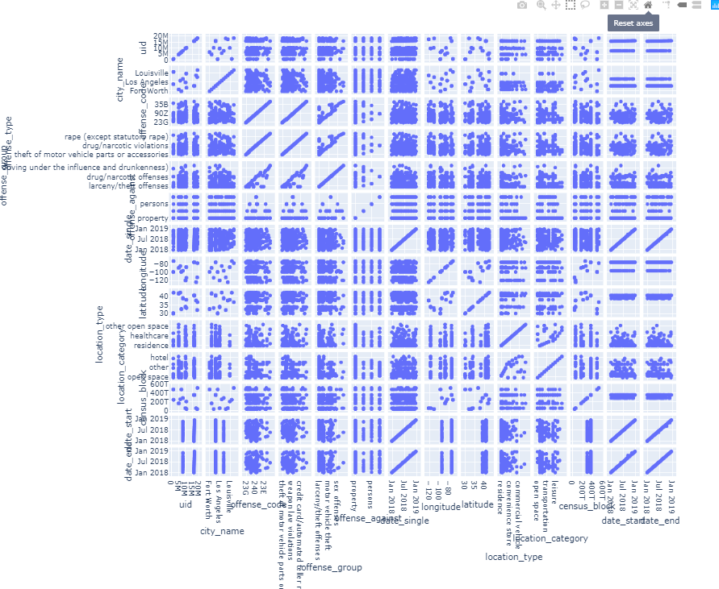
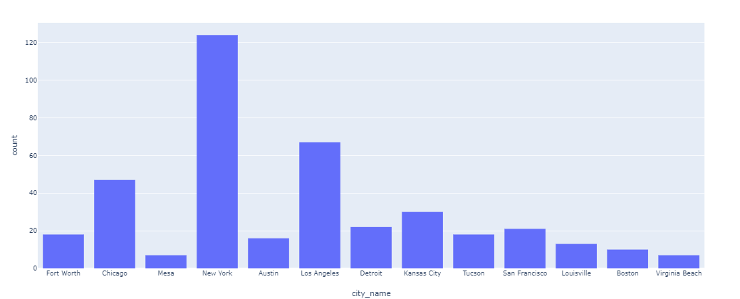
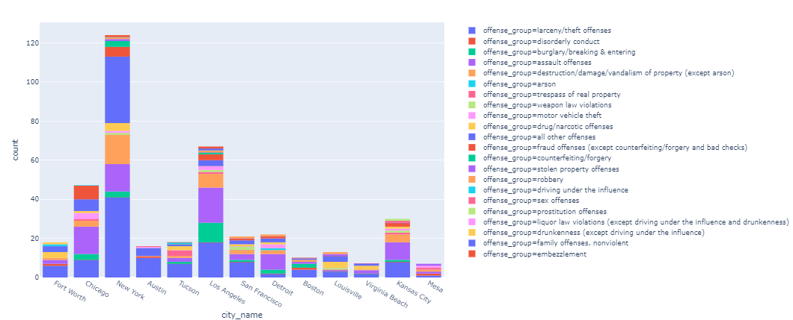
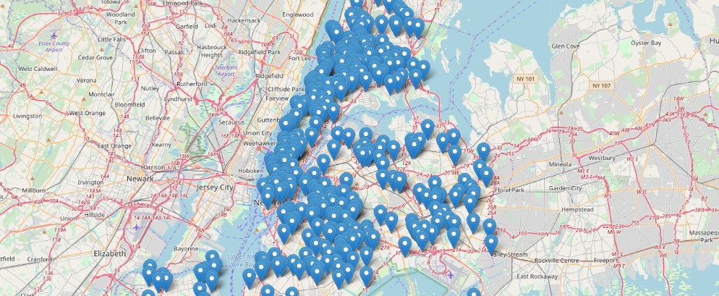
Analysis Methods—Program Type
Using variations of Visual Data representation and aggregates, conclusions can be made regarding city and crime type and density. The first primary tool used is a mapping tool where a function is created in the program that controls the initial map zoom and the re-centering of the map based on the data to be displayed. The second primary tool used is plotly.express which is a phenomenal interactive visualization tool that can be imported into python.
Interactive demonstration of the below visualizations to be given NOW!. All visualizations can also be found in write up.
Live Demo of Python Program

Slide 5
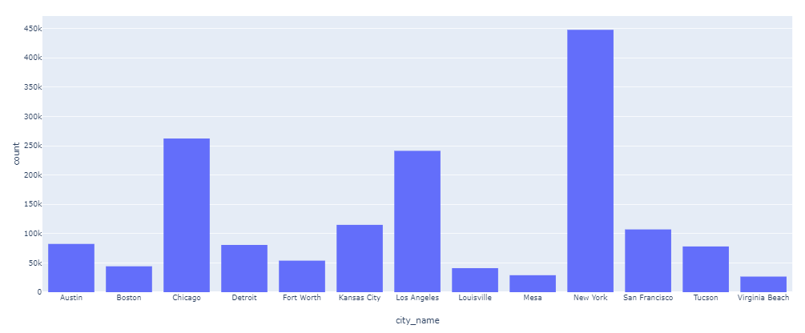
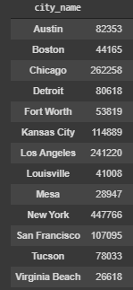
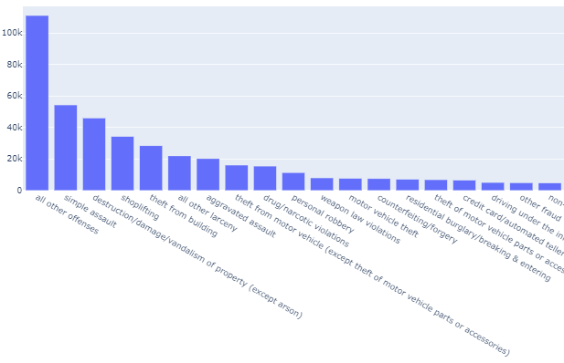
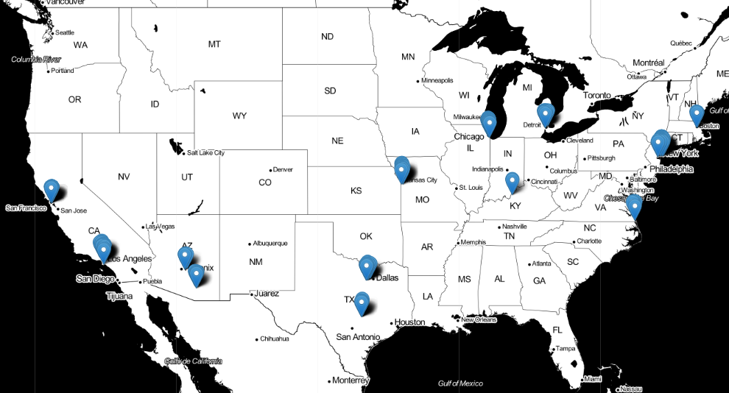
Conclusions
Some simple aggregation and visual analysis below allow some very confident and quick conclusions.
New York clearly has the highest non-normalized crime rate in the dataset that is analyzed.
A second break down could be by crime type within the city of new York.
What questions will be answered from this analysis?

Slide 6
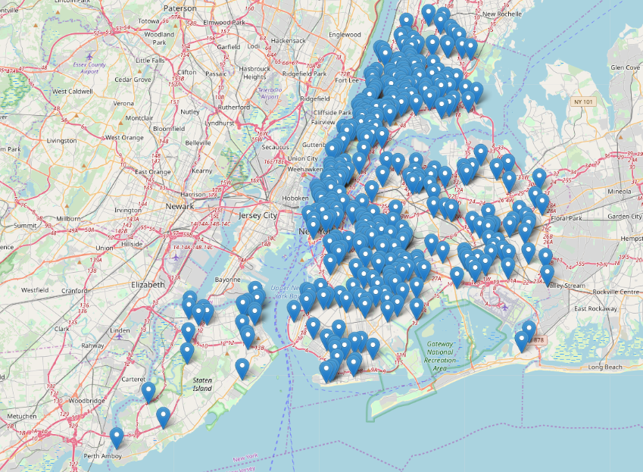
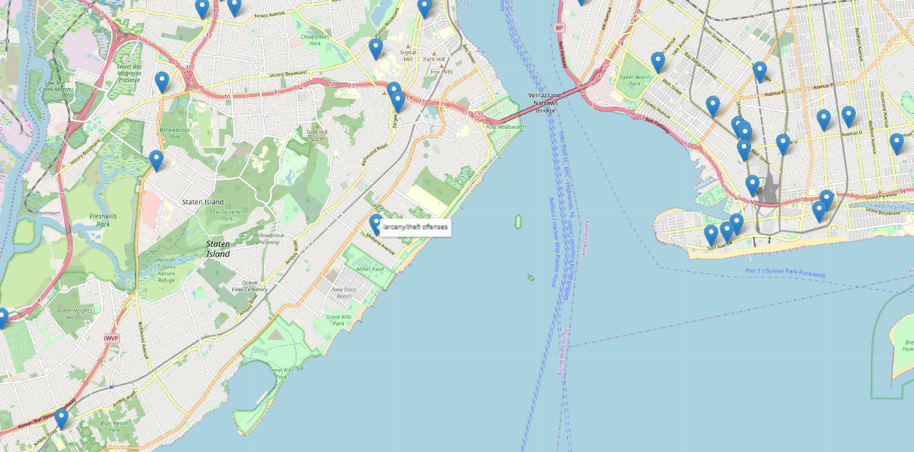
Conclusions
But what if I still wanted to live in New York?
Based on the tool below, a location without a large crime density could be identified.
New York Crime geography.

Slide 7

Justin Pate
IST-652
Based on the conclusions, both questions can be answered.
Questions?

